Slide 1
Copy Constructor Shallow Copy Deep Copy
Department of Computer Science & IT,
The University of Lahore.

Slide 2
Default Member-wise Assignment
Assignment operator (=) can be used to assign an object to another object of the same type.
Member-wise assignment: each data member of the object on the right of the assignment operator is assigned individually to the same data member in the object on the left

Slide 5
Default copy constructor
A type of constructor that is used to initialize an object with another object of the same type is known as default copy constructor.
It is by default available in all classes
syntax is ClassName(ClassName &Variable)
Notes:
If we don’t define our own copy constructor, the C++ compiler creates a default copy constructor for each class which does a member-wise copy between objects.

Slide 6
Copy Constructor for Class Date
Date::Date(Date &date)
{
// no need to check passed date arg
month = date.month;
day = date.day;
year = date.year;
}

Slide 7
Uses of the Copy Constructor
Implicitly called in 3 situations:
defining a new object from an existing object
passing an object by value
returning an object by value
Notes:
Copy constructor is called when a new object is created from an existing object, as a copy of the existing object. Assignment operator is called when an already initialized object is assigned a new value from another existing object.

Slide 8
Copy Constructor: Defining a New Object
Date d1(02,28,2020);
// init 2 local objects from d1
Date d2(d1);// pass by value
Date d3 = d1;// return value
// init a dynamic object from d1
Date* pdate = new Date(d1);
Notes:
Copy constructor is called when a new object is created from an existing object, as a copy of the existing object. Assignment operator is called when an already initialized object is assigned a new value from another existing object.

Slide 9
Copy Constructor:Passing Objects by Value
//copy constructor called for each value arg
unsigned dateDiff(Date d1, Date d2);
...
Date today;
Date d3(02, 21, 2000);
cout << dateDiff(d3, today);

Slide 10
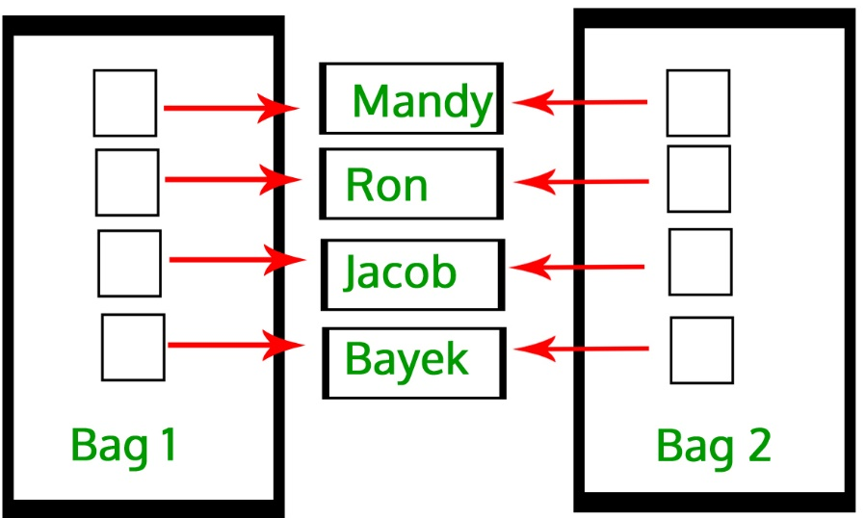
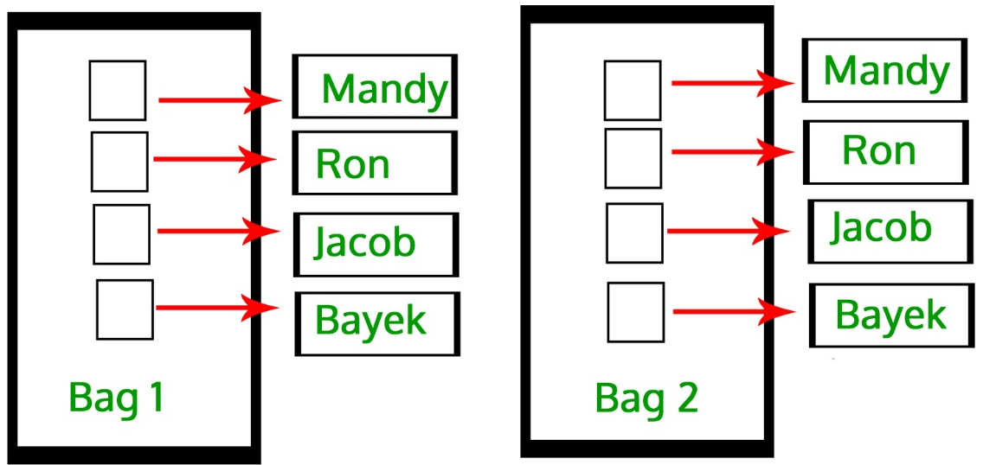
User-defined Copy Constructor, when required?
Default-copy Constructor do only “Shallow Copy”
We need user-defined copy-constructor,
When we need “Deep Copy” (for Dynamic Memory)
Notes:
Useful for dynamic memory or pointers

Slide 11
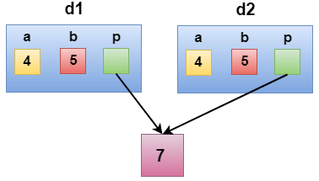
Shallow Copy
class Demo
{
int a;
int b;
int *p;
public:
Demo()
{
p=new int;
}
void setdata(int x,int y,int z)
{
a=x;
b=y;
*p=z;
}
void showdata()
{
cout << "value of a is : " <<a<< endl;
cout << "value of b is : " <<b<< endl;
cout << "value of *p is : " <<*p<< endl;
}
};
int main()
{
Demo d1;
d1.setdata(4,5,7);
Demo d2 = d1;
d2.showdata();
return 0;
}

Slide 12
Deep Copy
class Demo
{
public:
int a;
int b;
int *p;
Demo()
{
p=new int;
}
Demo(Demo &d)
{
a = d.a;
b = d.b;
p = new int;
*p = *(d.p);
}
void setdata(int x,int y,int z)
{
a=x;
b=y;
*p=z;
}

Slide 13
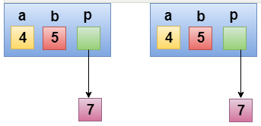
Deep Copy
void showdata()
{
cout << "value of a is : " <<a<< endl;
cout << "value of b is : " <<b<< endl;
cout << "value of *p is : " <<*p<< endl;
}
};
int main()
{
Demo d1;
d1.setdata(4,5,7);
Demo d2 = d1;
d2.showdata();
return 0;
}

Slide 14
Constant Reference Parameter
A constant reference parameter is a parameter passed by reference but declared as const, meaning it cannot be modified inside the function. This is useful when you want to avoid copying large objects but still ensure that the original object is not altered by the function.

Slide 15
Constant Reference Parameter
#include <iostream>
using namespace std;
class Rectangle {
public:
int length;
int width;
Rectangle(int l, int w) : length(l), width(w) {}
void area() const {
cout << "Area: " << length * width << endl;
}
void compare(const Rectangle &other) const {
if (length == other.length && width == other.width) {
cout << "Both rectangles are of equal size." << endl;
} else {
cout << "The rectangles are of different sizes." << endl;
}
}
};
int main() {
Rectangle rect1(10, 5);
Rectangle rect2(12, 5);
rect1.compare(rect2);
rect1.area();
rect2.area();
return 0;
}

